Slide 1
News Articles Sorting

Slide 2
Objective
Benefits
Development of a predictive model for classifying news article in different category . Integrate the model with python module and REST API, to predict a news article category from anywhere. Classified news allows users to access the information of interest quickly and effectively.
Python module can detect category of a news articles, can be integrate with any python program
Sending Request along with news to our REST API server, user got category of news article as Response, can be integrate with any program written in any language (C/C++, Java, Javascript, Golang etc.)

Slide 3
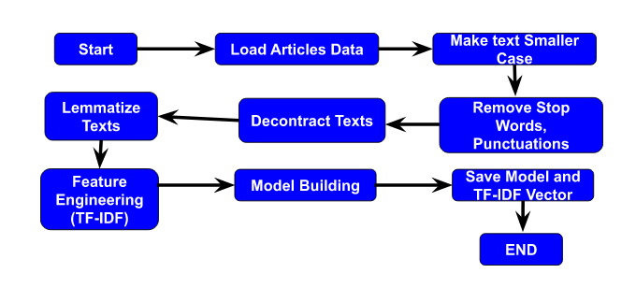
Architecture
Training Model and Save

Slide 4
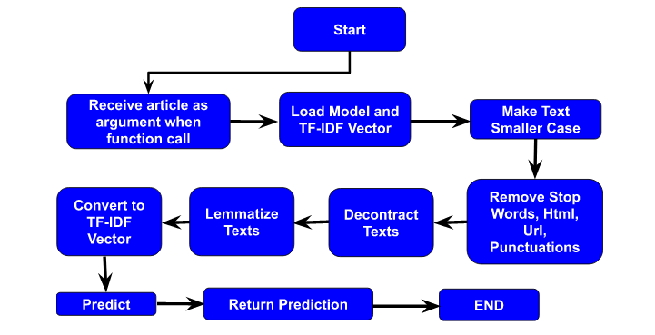
Architecture
Python Module

Slide 5
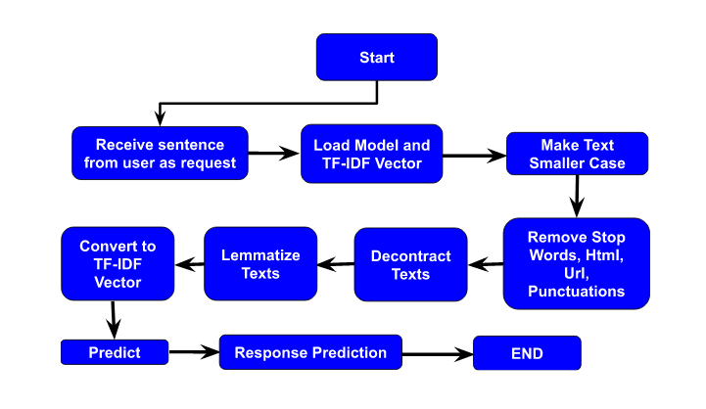
Architecture
Rest API / Web Interface

Slide 6
Dataset
BBC News Classification
I am using a public dataset from the BBC comprised of 1490 articles, each labeled under one of 5 categories: business, entertainment, politics, sport or tech.
Dataset URL : https://www.kaggle.com/c/learn-ai-bbc/data
Data fields
ArticleId - Article id unique # given to the record
Article - text of the header and article
Category - category of the article (tech, business, sport, entertainment, politics/li>

Slide 7
Text Preprocessing
Text Preprocessing is the practice of cleaning and preparing text data.
Make smaller case
Remove html
Remove URL
Removing punctuation
Remove non-alphabetic characters
Decontracted Text

Slide 8
Feature Engineering
Machines can’t understand characters or words or sentences hence we need to encode these words into some specific numeric form. There are various ways to perform feature extraction from text. Some popular and mostly used are:-
Bag of Words model : The idea is to take the whole text data and count their frequency of occurrence, and map the words with their frequency. This method doesn’t care about the order of the words.
TF-IDF Model : The BOW model doesn’t give good results since it has a drawback.
Term frequency (TF): Number of times a term has appeared in a document.
Inverse Document Frequency (IDF): The inverse document frequency (IDF ) is a measure of how rare a word is in a document. If a word appears in almost every document means it’s not significant for the classification
IDF of a word is = log(N/n)
N: total number of documents.
n: number of documents containing a term (word)
TF-IDF Evaluates how relevant is a word to its sentence in a collection of sentences or documents.

Slide 9
Model Training
We are taking TF-IDF Vector of the dataset and split it to train and test set. After that we train our model with different algorithm and check accuracy, confusion matrix, precision, recall, f1-score, support etc.
Let's see classification report in more details…

Slide 10
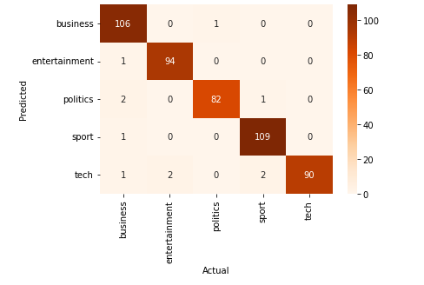
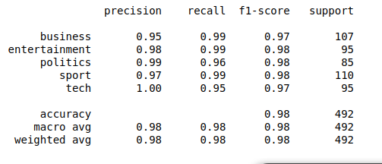
Classification Report
1. Logistic Regression

Slide 11
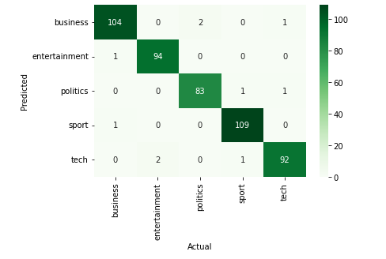
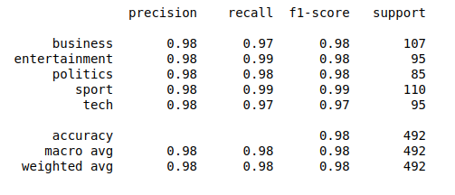
Classification Report
2. Logistic Regression with L2 Regularizations (Alpha = 50)

Slide 12
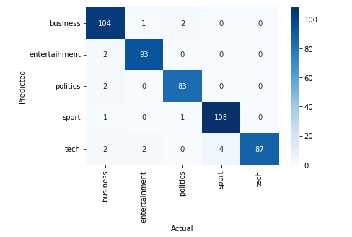
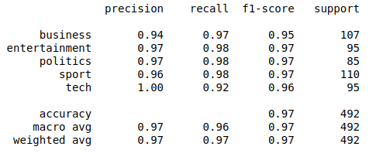
Classification Report
3. Logistic Regression with L1 Regularizations (Alpha = 20)

Slide 13
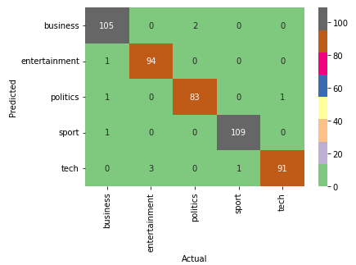
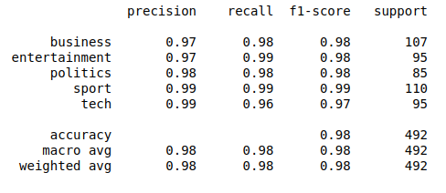
Classification Report
4. Support Vector Machine (Linear Kernel)

Slide 14
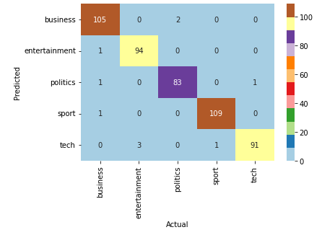
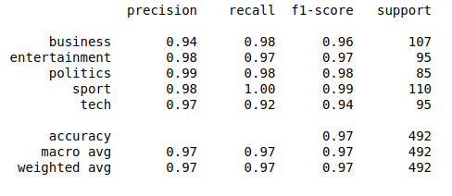
Classification Report
5. Random Forest Classifier

Slide 15
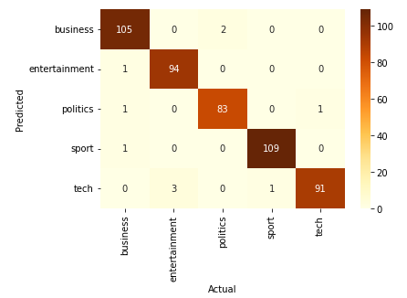
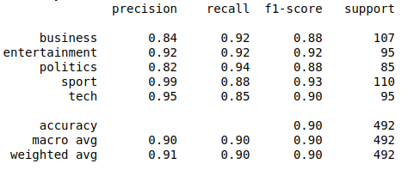
Classification Report
6. K Nearest Neighbors

Slide 16
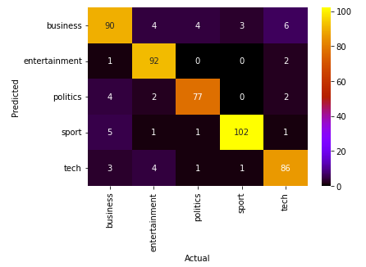
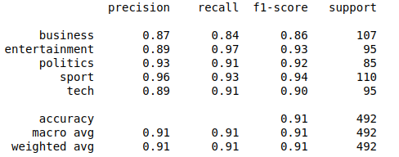
Classification Report
7. Gaussian Naive Bayes

Slide 17
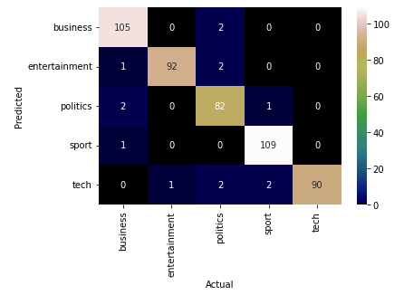
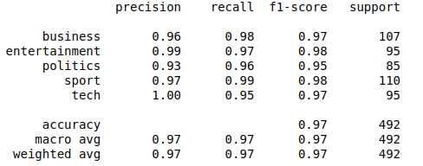
Classification Report
8. Multinomial Naive Bayes

Slide 18
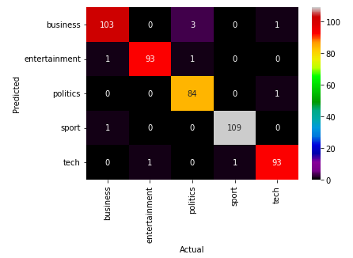
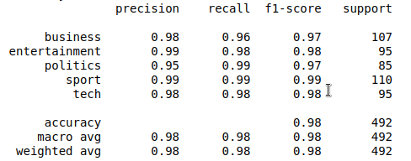
Classification Report
9. Complement Naive Bayes

Slide 19
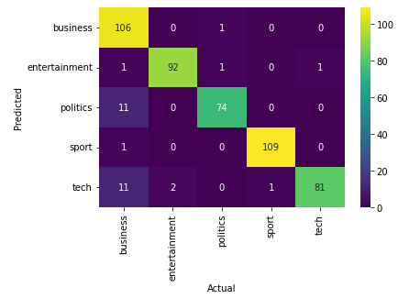
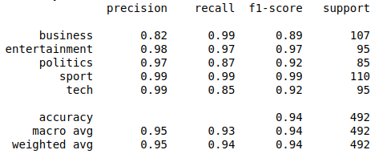
Classification Report
10. Bernoulli Naive Bayes

Slide 20
Model Selection
Almost every algorithm working well, we are taking Complement Naive Bayes
It gives good accuracy
For all category precision is same (98%).
Save TF-IDF Vector and Model as pickle.

Slide 21
Prediction
Get article as request (for REST API) or argument(for python module).
Make smaller case
Remove html
Remove URL
Removing punctuation
Remove non-alphabetic characters
Decontracted Text
Lemmatize Text
Load TF-IDF vector and convert article to TF-IDF vector.
Load Model
Predict category of news article

Slide 22
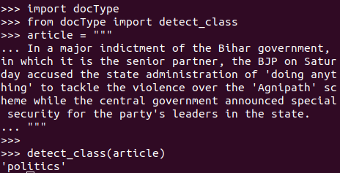
What is docType Python Module ?
docType is a python module available on pip perform this classification task by 3 lines of code.
User have to install it by pip install docType.
Assign article to a string.
Call detect_class function and pass news article as argument of function.
And we receive category of the article.

Slide 23
How docType works ?
Get news article through argument whenever someone call detect_class function and pass article as argument.
Make smaller case
Remove html
Remove URL
Removing punctuation
Remove non-alphabetic characters
Decontracted Text
Lemmatize Text
Load TF-IDF vector and convert article to TF-IDF vector.
Load Model
Predict category of news article and return it.

Slide 24
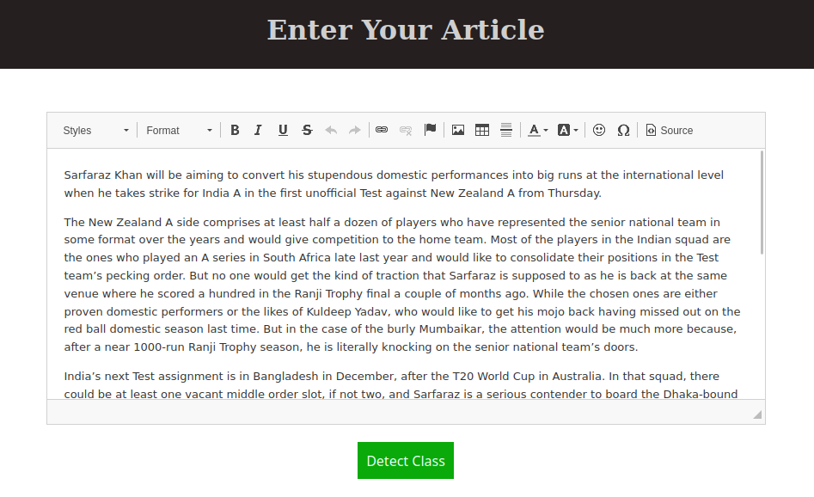

About Web Interface
Website is deployed on https://doctype.herokuapp.com/
User have to write the news
article.
Our server predict category
of the article.

Slide 25
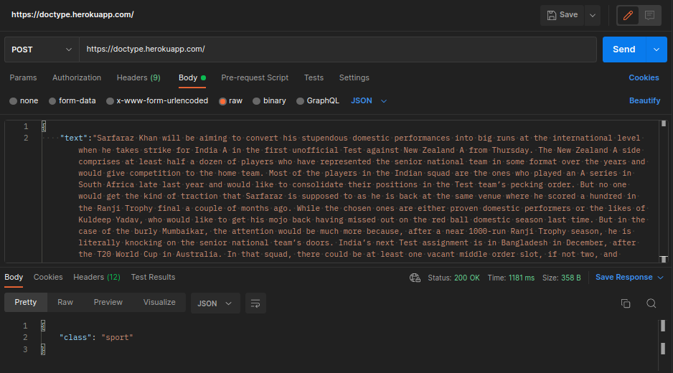
About REST API
REST Api is deployed on https://doctype.herokuapp.com/
User have to do a POST Request with news article.
Using docType module our server predict category of the article and send it as response.

Slide 26
END

